Slide 1
Analog Electronics Lab Experiment-3
Instructors’ name:
Section (P5):
Sambhavi Shukla
Teena Gakhar
Section (P6):
Ashish Kumar Verma
Pavitra Sharma

Slide 2
Basic Configurations of Op-Amp

Slide 3
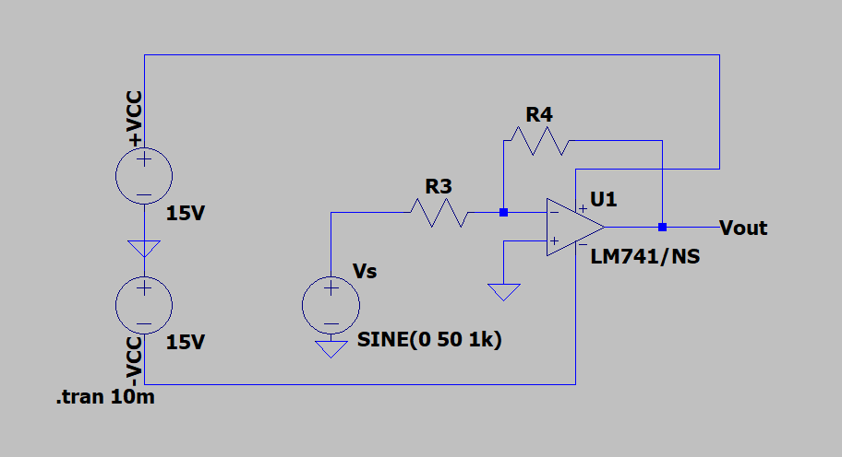
Circuit
INVERTING OP-AMP

Slide 4
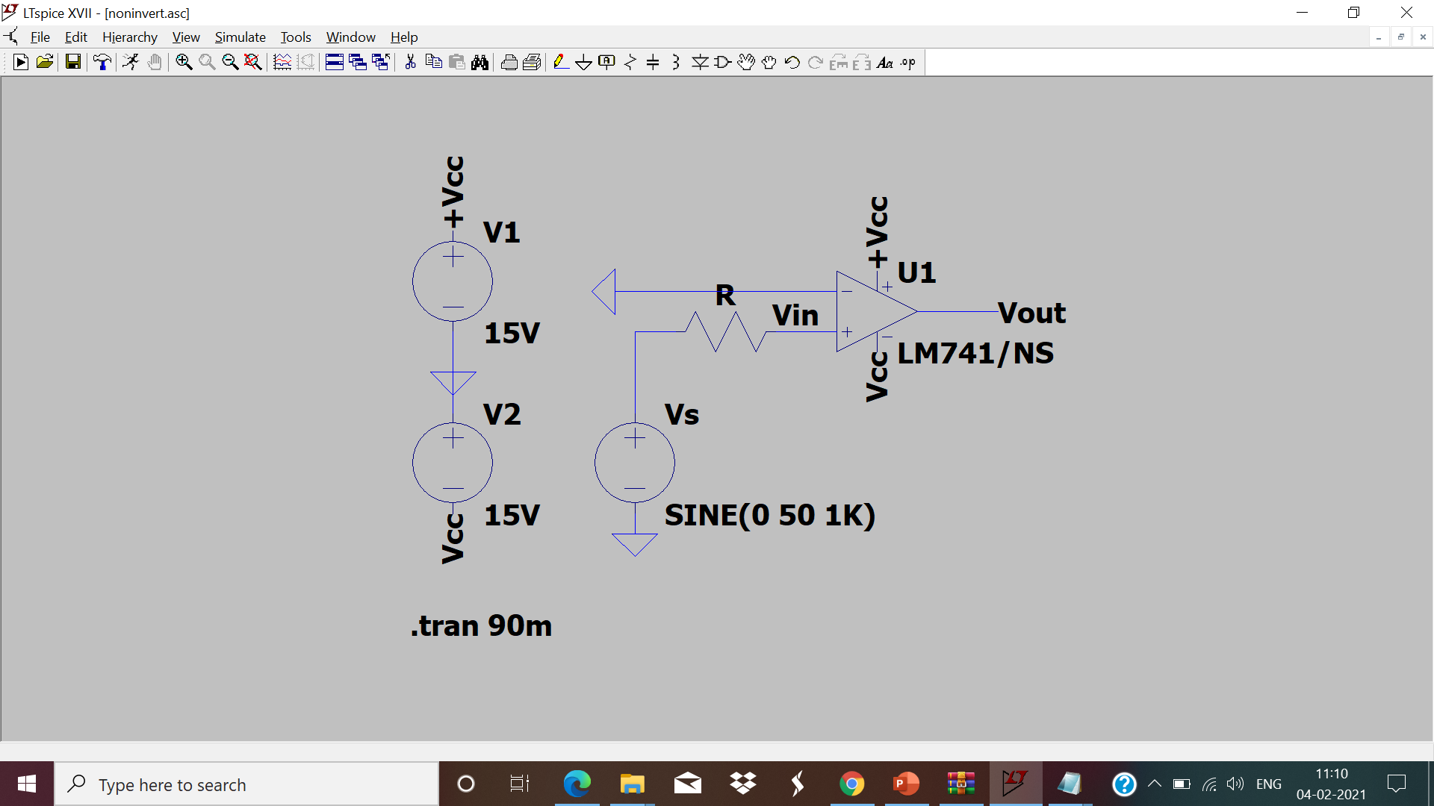
NON -INVERTING OP-AMP

Slide 5
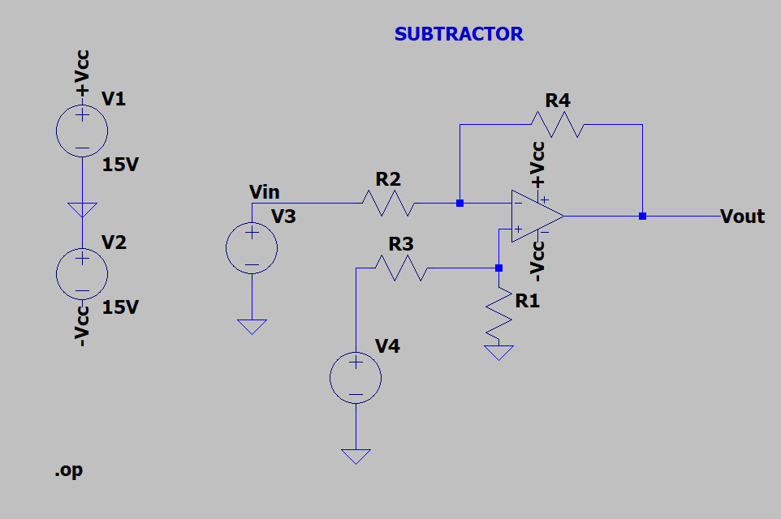
SUBTRACTOR

Slide 6
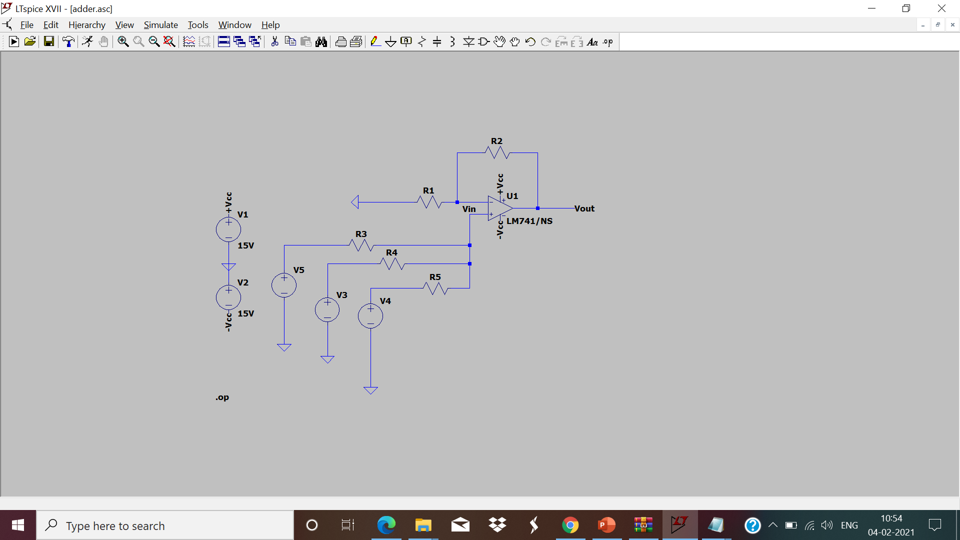
ADDER CIRCUIT

Slide 7
Assignment:
To study the basic configuration of OPAMP (IC-741)
1) Inverting Mode
2) Non-inverting Mode
3) Adder
4) Subtractor
Upload a single PDF file on Nalanda which includes
1)Circuit diagrams for all four configurations.
2)Simulated and theoretical values of voltage gain (Av) and input-output voltage waveforms with magnitude for inverting and non-inverting mode.
3)Simulated and theoretical values of output voltage (Vo) for adder
4)Simulated and theoretical values of output voltage (Vo) for subtractor
Submit the report in a single PDF format (file name should be your ID) on Nalanda within 48 hrs., after your lab section. ( 2 marks deduction for late submission ) Personal submission on email will not be considered.

